Slide 1
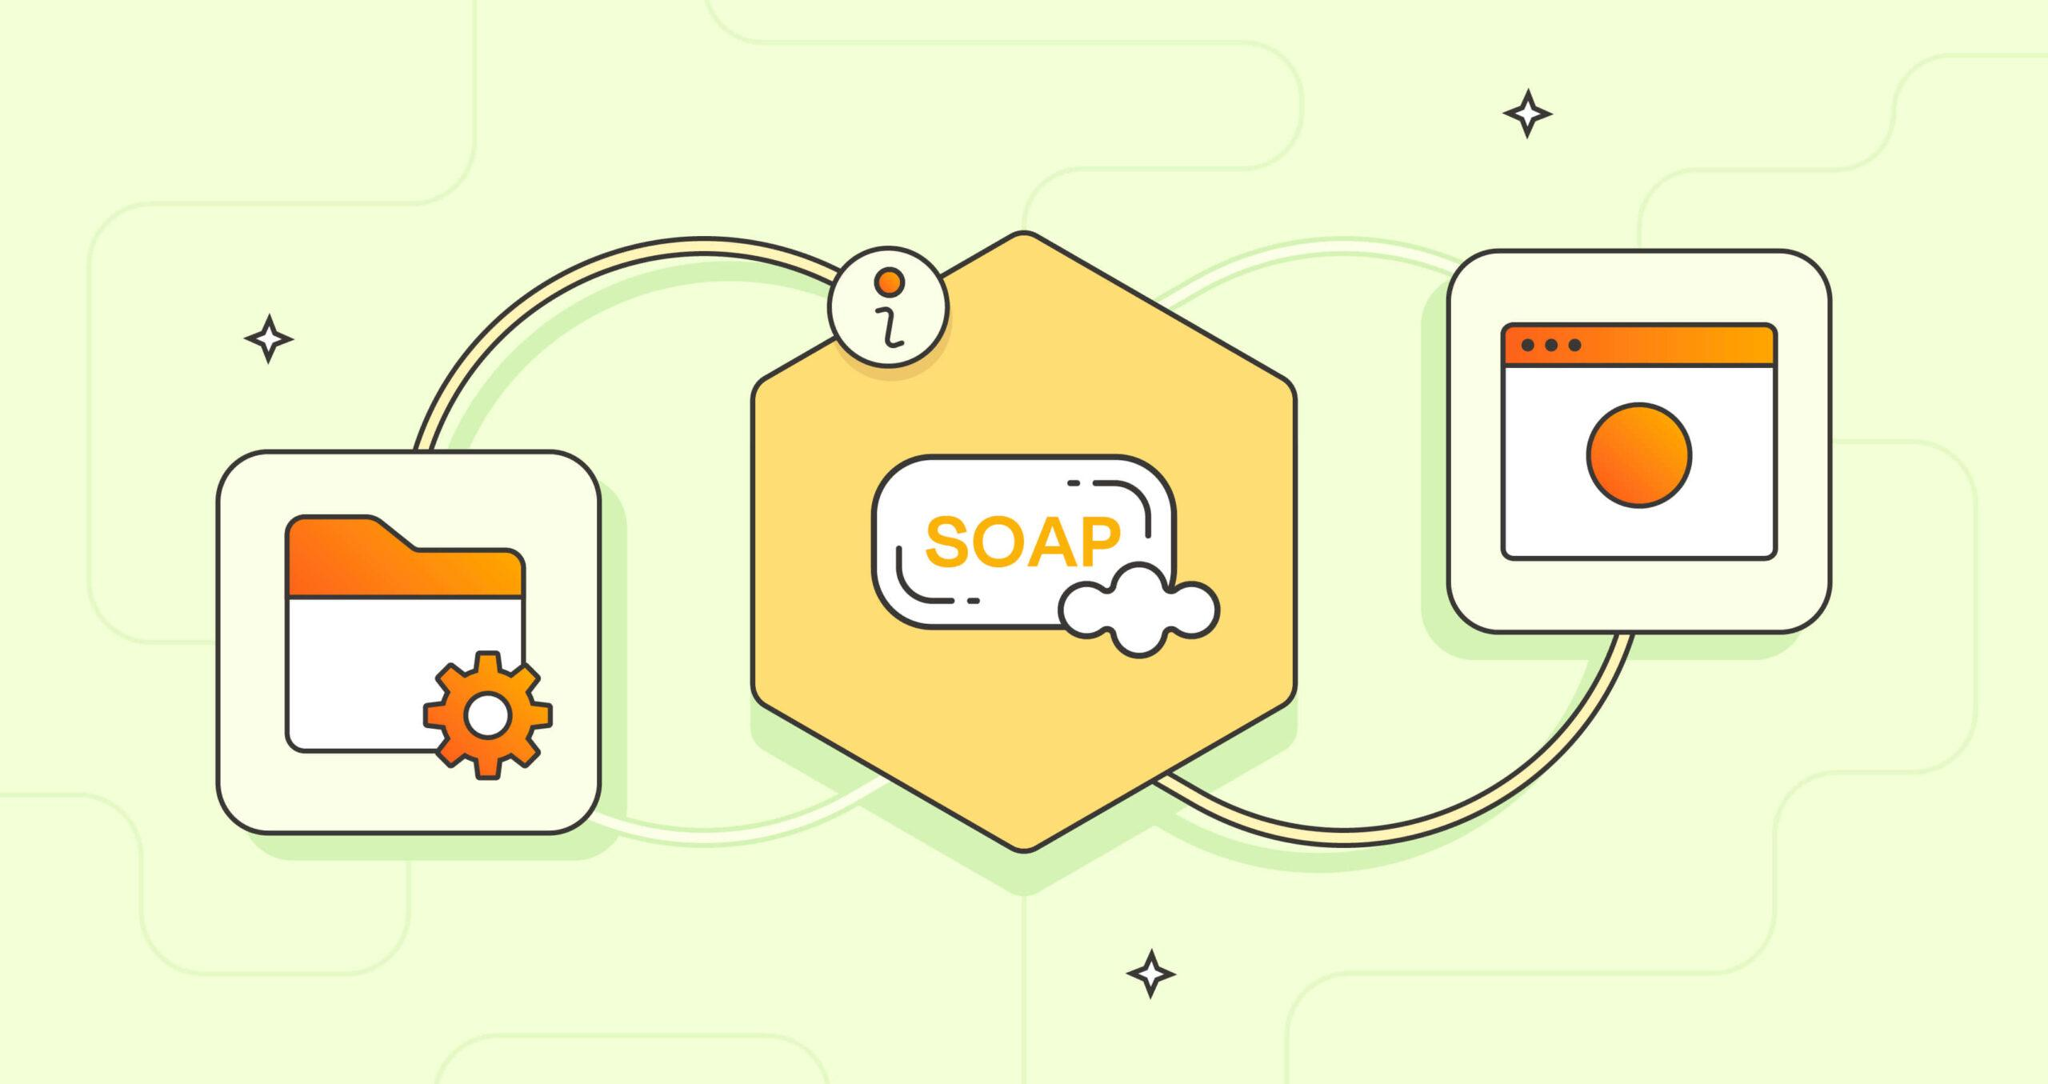
API
Simple Object Access Protocol

Slide 2
Introduction to SOAP
Definition: SOAP (Simple Object Access Protocol) is a protocol for exchanging structured information in web services
Messaging Format: SOAP messages are XML-based and include headers and body elements for communication
Usage: Commonly used in enterprise systems for synchronous and reliable communication

Slide 3
Structure of SOAP Messages
Envelope: Contains the SOAP message structure with mandatory elements like Header and Body
Header: Optional section for including additional information such as authentication credentials or routing details
Body: Contains the main content of the SOAP message, such as request data or response data

Slide 4
Creating SOAP Services
Server-Side: Develop SOAP services using languages like Java (JAX-WS), .NET (WCF), or Python (zeep) with SOAP libraries
WSDL (Web Services Description Language): Define service interfaces, operations, input/output parameters, and bindings in WSDL files
Deployment: Deploy SOAP services on web servers or application servers for accessibility

Slide 5
Consuming SOAP APIs
Client-Side: Create SOAP clients in various programming languages to consume SOAP services
Client Libraries: Use SOAP client libraries (suds, zeep, SOAPpy) for generating client code from WSDL files
Request-Response: Send SOAP requests with specified operations and parameters, receive SOAP responses from the server

Slide 6
Advantages of SOAP APIs
Formal Standard: SOAP is a formal standard with well-defined specifications and messaging formats
Reliability: Supports reliable messaging with features like message acknowledgments and retries
Security: Provides built-in support for security mechanisms such as WS-Security for message-level encryption and authentication
Interoperability: Ensures interoperability between different platforms and programming languages

Slide 7
SOAP vs. RESTful APIs
Messaging Format: SOAP uses XML-based messages,
while RESTful APIs often use JSON or XML.
Protocols: SOAP relies on protocols like HTTP, SMTP, or JMS,
while RESTful APIs primarily use HTTP
Complexity: SOAP APIs tend to be more complex due to strict message formats and standards,
while RESTful APIs are simpler and more lightweight
Use Cases: SOAP is suitable for enterprise-level integrations and complex systems,
while RESTful APIs are preferred for web-based and resource-oriented services.

Slide 8
Best Practices for SOAP APIs
Versioning: Implement versioning strategies in WSDL files to manage changes and ensure compatibility
Error Handling: Define standardized error messages and fault codes for SOAP faults and exceptions
Security Policies: Configure security policies such as authentication, encryption, and message integrity using WS-Security standards
Performance Optimization: Optimize SOAP message size, use compression techniques, and cache responses for better performance

Slide 9
Testing and Debugging SOAP APIs
Unit Testing: Test SOAP services and clients using unit testing frameworks (JUnit, NUnit, etc.)
Integration Testing: Test end-to-end SOAP interactions with other systems or services
Tool Support: Use SOAPUI, Postman, or custom testing tools for functional testing, load testing, and security testing of SOAP APIs
Debugging: Debug SOAP API issues using logging, tracing, and monitoring tools

Slide 10
Real-world Examples of SOAP APIs
Enterprise Systems: Showcase examples of SOAP APIs used in enterprise applications, such as CRM systems, banking systems, and ERP solutions
Integration Scenarios: Explore real-world integration scenarios where SOAP APIs facilitate data exchange and business processes across multiple systems
Benefits: Discuss the benefits of SOAP APIs in terms of reliability, security, and standardization for mission-critical applications

Slide 11
Future Trends in SOAP APIs
Legacy Support: Continued use of SOAP APIs for legacy systems and enterprise integrations
Hybrid Approaches: Adoption of hybrid approaches combining SOAP and RESTful APIs for different use cases
Industry Standards: Alignment with evolving industry standards and protocols for interoperability and compatibility
Modernization Strategies: Strategies for modernizing SOAP-based systems and migrating to newer architectures

